Slide 1
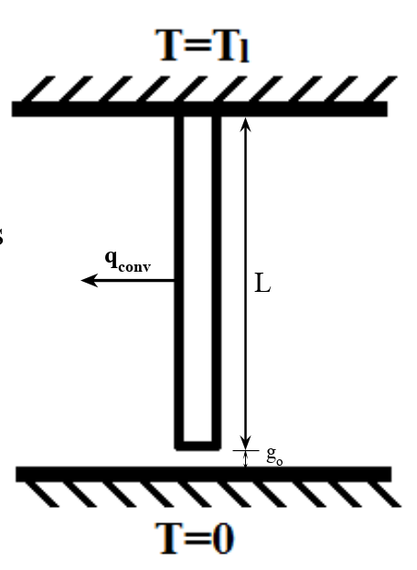

Approach method
Approach direction:
Team decided to start this problem in the simplest case. A steady state condition. Assume there is a prefect gap distance which will make the bar just touch the bottom, and as soon as it touch the bottom, the bar has reached heat transfer equilibrium.
Assign values to variables
$T_{top}=T1, T_{bottom}=0°C, h_{conv}, length L,$
$conductivity k,$young’s modulus E , thermal contact resistance R and thermal expension $α are$
assumed as known variables
The unknown variables is $g_{0},$the gap distance
Start with energy balance equation, write down the energy balance equation from the bar and then apply nondimensionalization.

Slide 2
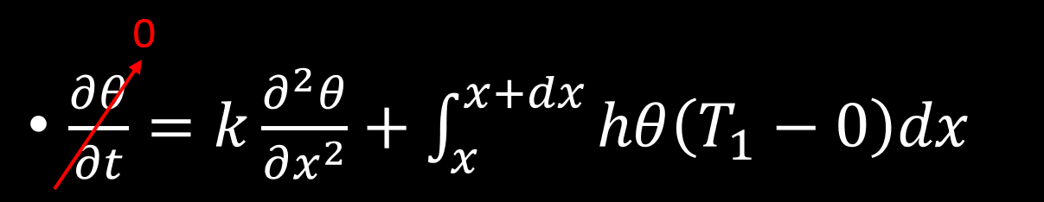

Governing equation and boundary conditions
$θ=\frac{T−0}{T_{1}−0}=\frac{T}{T_{1}}$, $t=\frac{α}{L^{2}}t′$,$x=\frac{x′}{L},u=\frac{u′}{L}, σ=\frac{σ′}{E}$
0<x<1
$\frac{∂^{2}u}{∂x^{2}}=μ\frac{∂θ}{∂x}$ 0<x<1
$μ=α(T_{top}−T_{bottom})$
B.C.@x=0, $θ$(0)=0
B.C.@x=L+ $g_{0} ,$ -k $\frac{dθ}{dx}$=R($θ$(L+ $g_{0}$)- $T_{bottom}$)

Slide 3
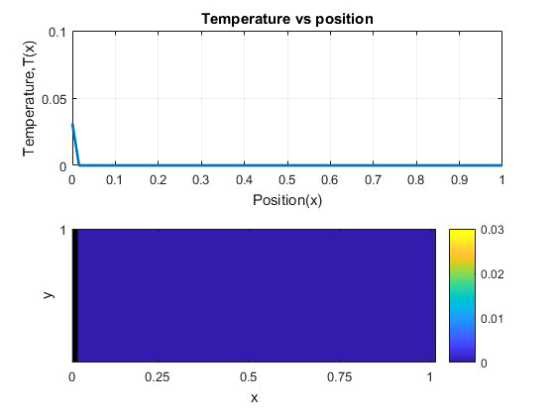




Progress So far
Non-Dimensional heat equation
$\frac{∂θ}{∂t}$ $=$ c$\frac{∂^{2}θ}{∂x^{2}}$ 0<x<1
(i) @t=0, $θ$(x,0)=0 (initially at 0 temperature)
(ii)@x=0, $θ$’(0,t)= $C(constant heat flux)$
$Solved 1D Heat equation Numerically using Matlab$
Method used was Crank Nicholson Technique
$Case 1:When bottom end is NOT in contact with the$
$$floor at all time$$
$Case 2:When bottom end is always in contact$
$with the floor ($@x=1, $θ$(1,t)= 0

